Slide 1


Exploratory Data Analysis of U.S. Motor Vehicle Registrations
Analyzing trends across decades, states, and vehicle types. Focus: Auto, Bus, Truck, Motorcycle.
by Jaya Sinha

Slide 2
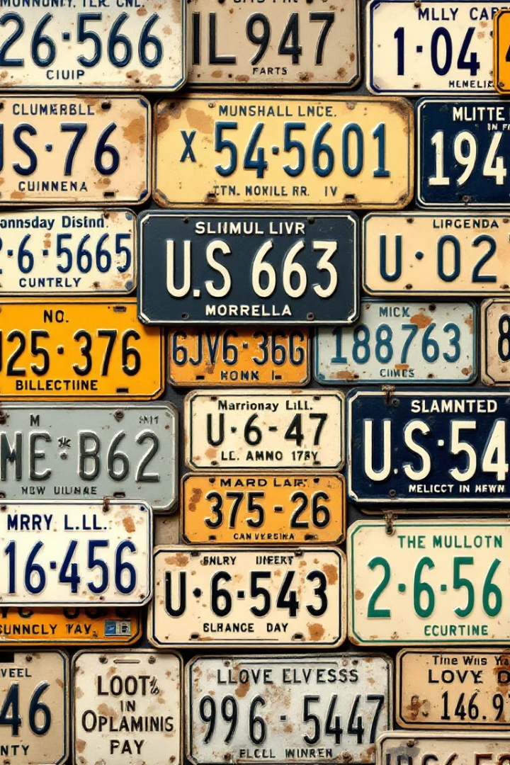
Introduction
National registration trends
Four vehicle types
Auto, Bus, Truck, Motorcycle
Historic perspective
Decades & states
Comprehensive dataset

Slide 3
Dataset Overview
6,293 records
Since 1900
Columns
Year, State, vehicle counts
Longitudinal coverage
Year
State
Auto, Bus, Truck, Motorcycle

Slide 4




Data Cleaning
Removed missing values
Added Total Vehicles
Consistent dataset

Slide 5
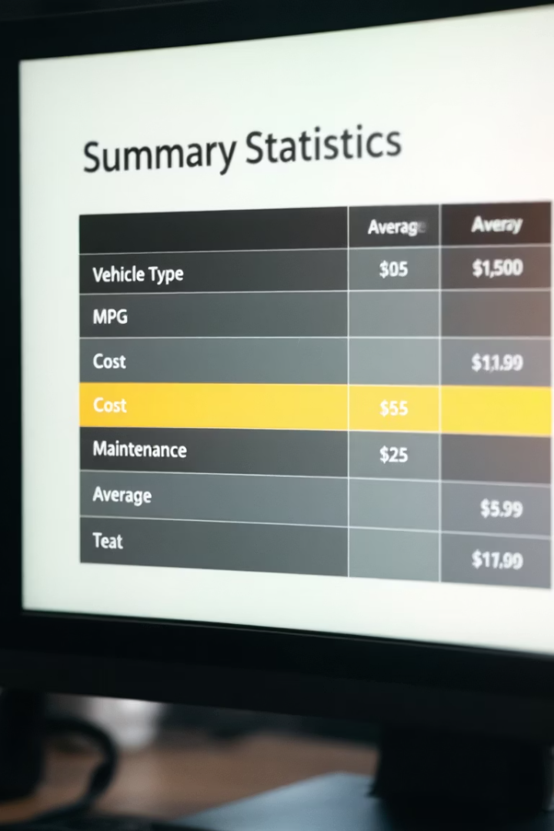
Summary Statistics
describe() used
Auto: highest average
Quick numeric summary
Dominant vehicle type
Motorcycle, Bus: lowest medians
Less common

Slide 6
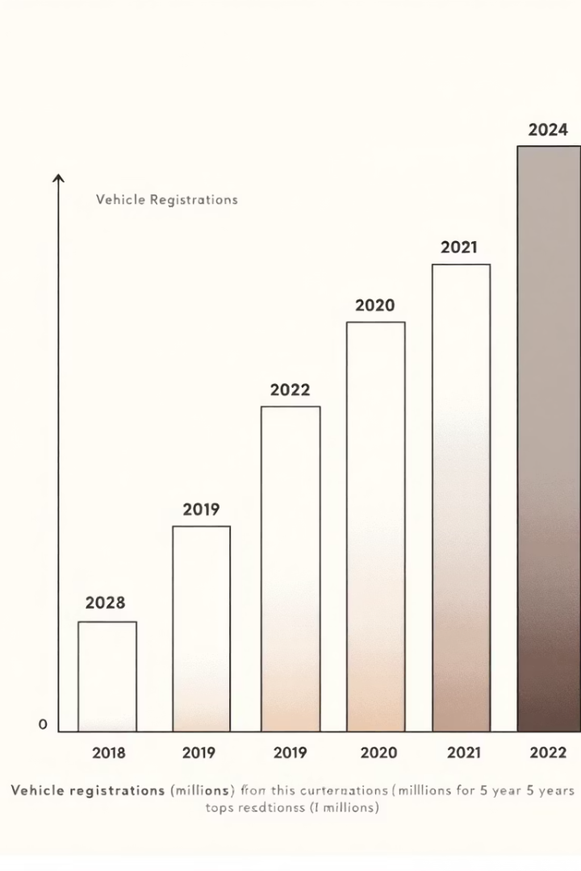



Top Years for Vehicle Registrations
Top 20 years
Peak registrations
Recent decades
Highest counts
Economic, policy impact
Growth drivers

Slide 7




Top 10 States by Vehicle Registrations
California
Texas
1
2
Consistently highest
Large population
Other top states
4
3
Florida
Infrastructure, demand
High economic activity

Slide 8
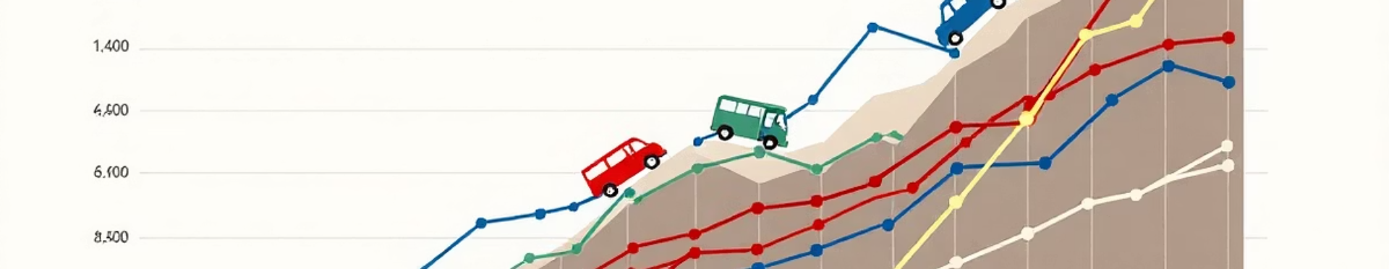
Vehicle Type Trends Over Time
1
2
3
Autos, Trucks
Buses
Motorcycles
Upward trends
Stable counts
Cyclical growth

Slide 9




Vehicle Type Market Share (Overall)
Autos
1
Over 60% share
Trucks
2
Second largest
Motorcycles
3
Small share
Buses
4
Least represented

Slide 10
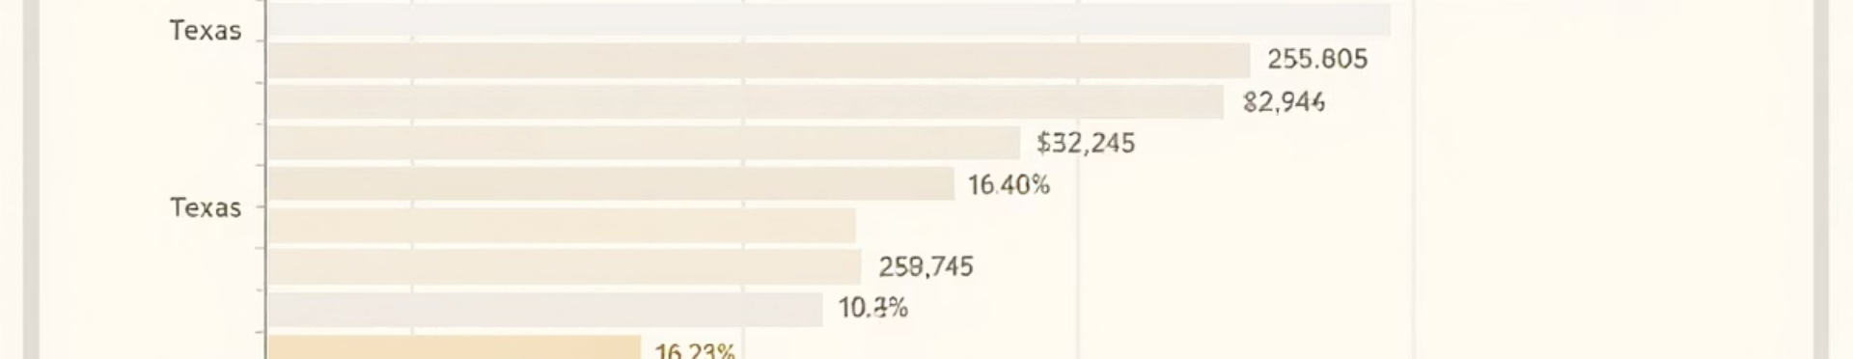
Top States by Motorcycle Registrations
1
2
3
California
Texas
Florida
Most motorcycles
High registrations
Popular for riding

Slide 11
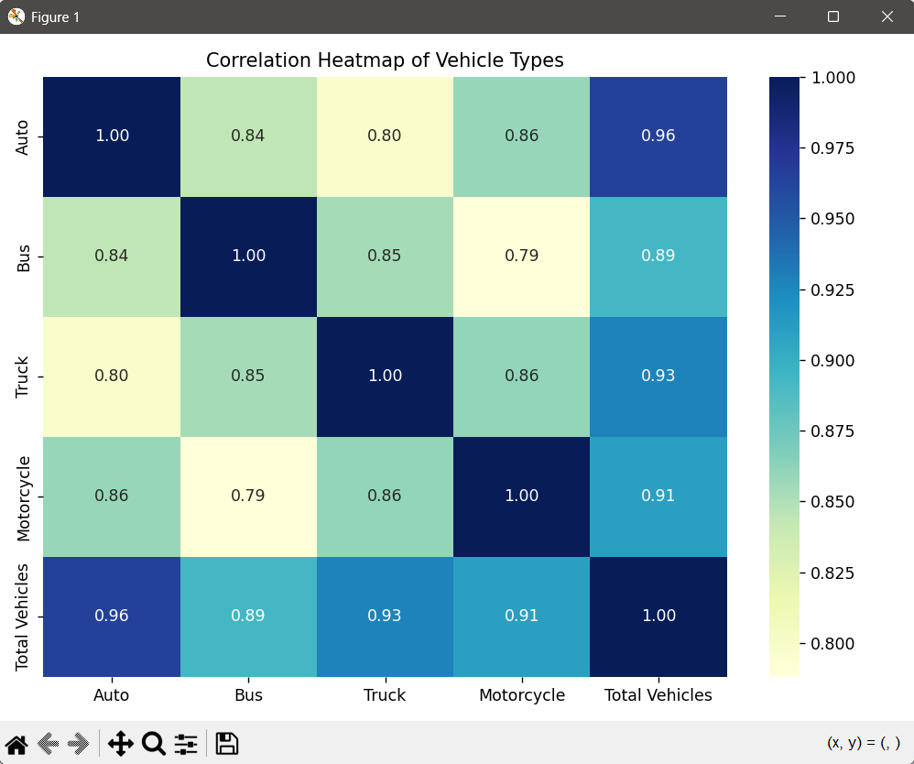
Correlation Heatmap
Shows correlation between different vehicle types (Auto, Bus, Truck, and Motorcycle).
It calculates the Pearson correlation between each vehicle type.
sns.heatmap(corr_matrix, annot=True, cmap='YlGnBu', fmt=".2f")

